Slide 1
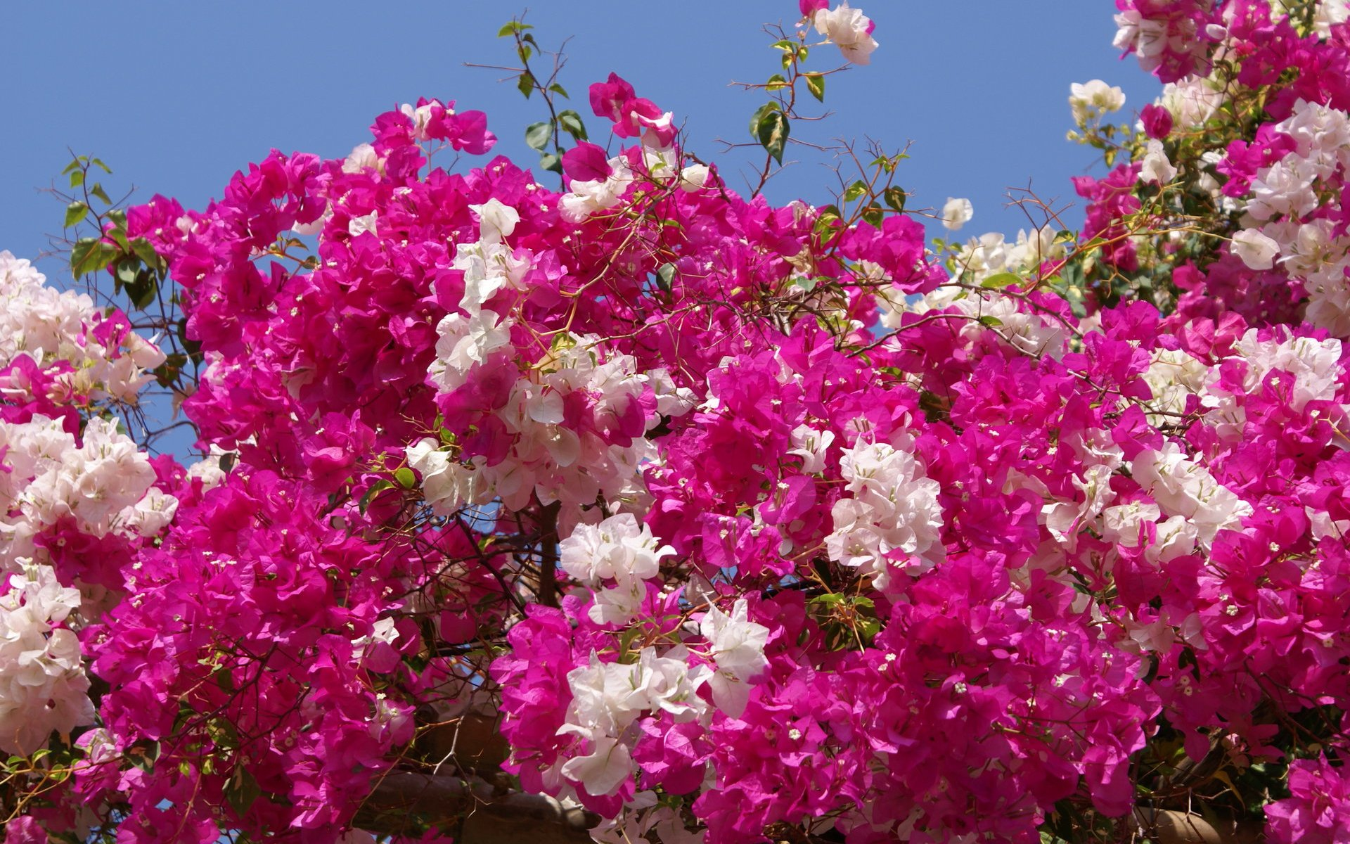






WELCOME TO YOU ALL

Slide 2


Teachers Identity
Md. Abdul Jalil MA (B Ed 1st )
Assistant Teacher (English)
Horipur High School
Tanore –Rajshahi
Resource Teacher (English) (SEQAEP)
Master Trainer (English) (TQI & BRAC)
Email: jalilrajshahi@gmail.com
Skype: abdul.jalil433

Slide 3
Lesson Introduction
Class- Ten
Sub: English
Unit-Grammar
Lesson- Dialogue
Time-50

Slide 4
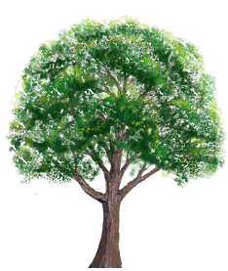
What is the picture about ?

Slide 5
Todays topic:
Writing
Dialogue.

Slide 6
Objects
By the end of the lesson ss will be able to
Talk about the importance of tree plantation.
Tell the importance of Tree.
Fill in the gaps.
Act out a dialogue .

Slide 7
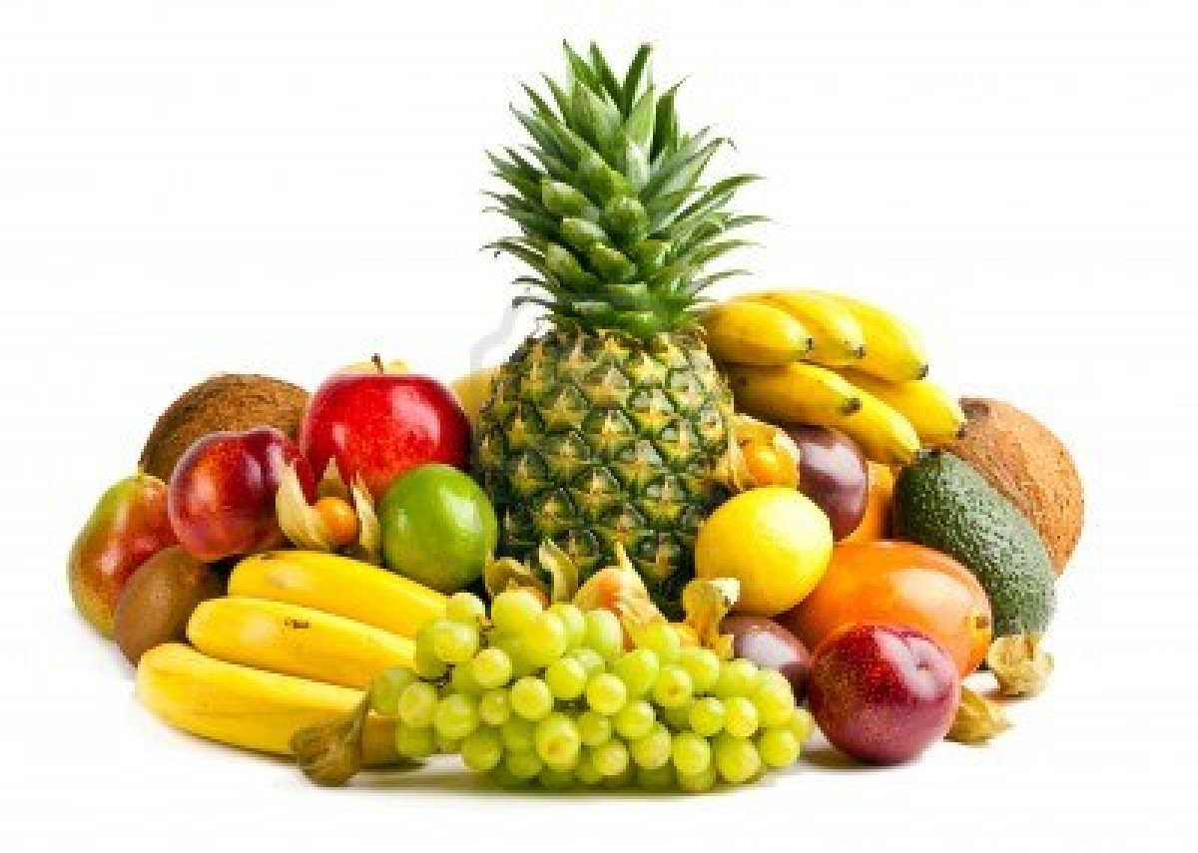

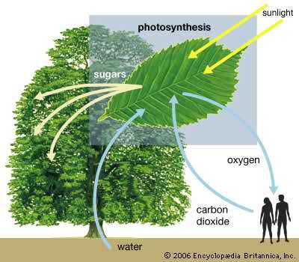
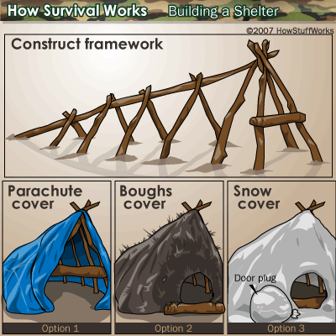
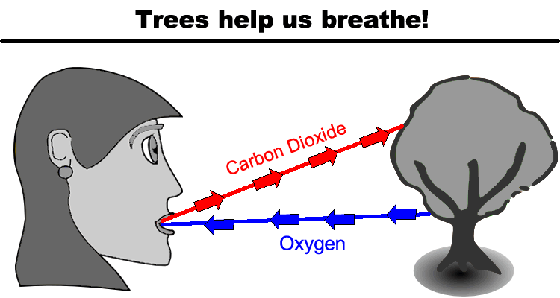
Look at the pictures and say what you see in them ?(indi 5 min)

Slide 8
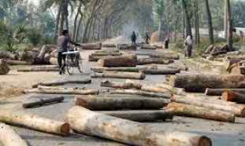
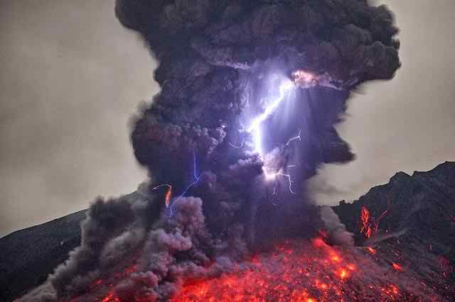
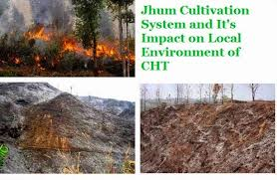
What are the main reasons of lack of trees ?

Slide 9
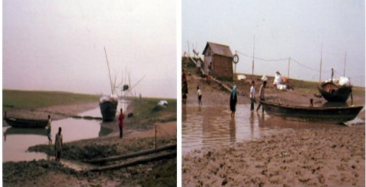
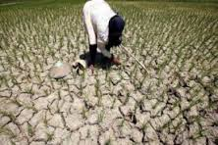
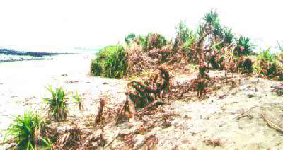
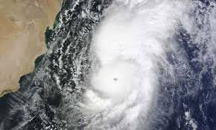
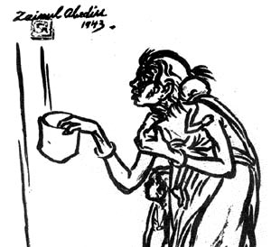
What are the impact of cutting trees ?(work in Group 5 min)

Slide 10
Fill in the gaps with the clue :
Trees –(a)- very important to us. They help us in many ways. They -(b)- us oxygen, food, wood and shade . They protect us from air pollution. But many people are not aware of this. They -(c)-down trees every moment with out consideration. If they -(d)-to do it, one day there will be no trees left on earth. When this really happens, our life will be at stake. So we should-(e)- this practice immediately and grow more and more trees for our survival.
continue | cut | be | follow | give | plant | stop

Slide 12
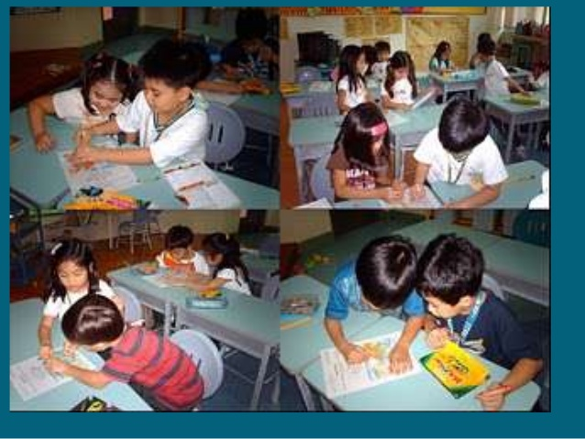
Act out a dialogue with your partner

Slide 13
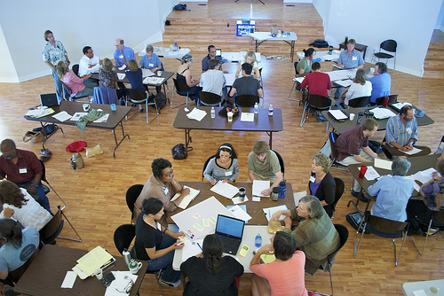
Write a dialogue about the importance of tree Plantation . (In group)

Slide 14

Home Work: Write a Paragraph about “Tree Plantation”

Slide 15
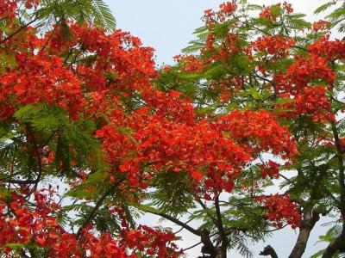
Good Bye

Slide 16




